Slide 1

BELLA BEAT CO.
A very big wellness company tries to improve its customer satisfaction through its data .
We’re here to find out how we will do so !

Slide 2
Gathering data about weight, calories, activity minuites and sleep . Also testing my hypothesis on some relationships
Here’s what I concluded:
PS. Act is aka Activities

Slide 3
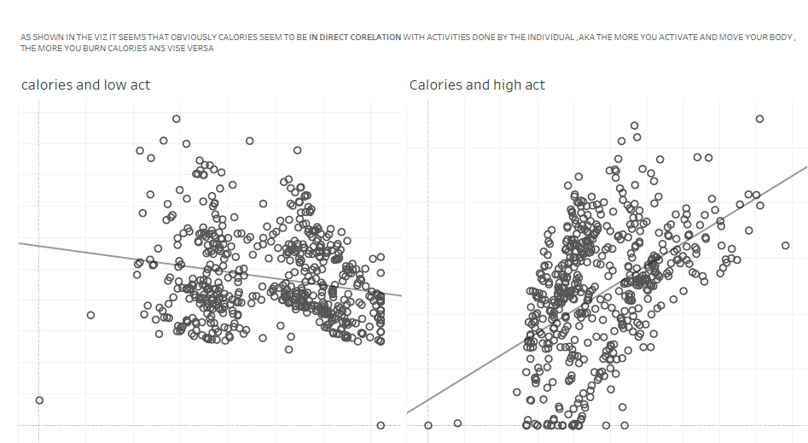
Calories seem to have a strong relation with activity minuites spent. Where high activities burn more calories, while sedentary minuites seem to be the complete opposite as shown:

Slide 4
Now testing relationships in terms of sleep and activities
Kindly Keep up with the upcoming slide.

Slide 5
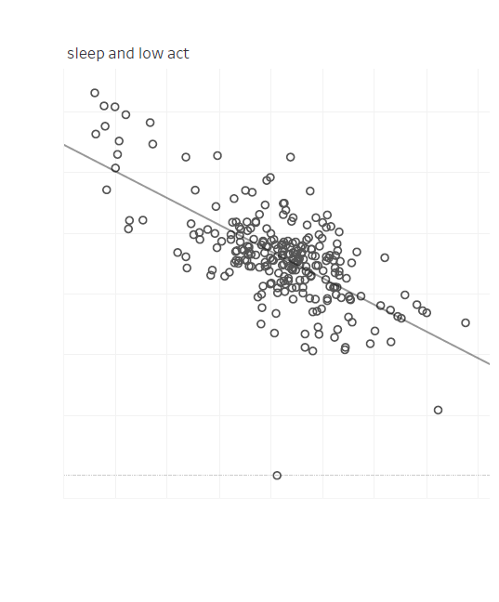
low activities and sleeping rates
High sleeping rates is equivalent to less activated bodies, it affects the way your body function

Slide 6
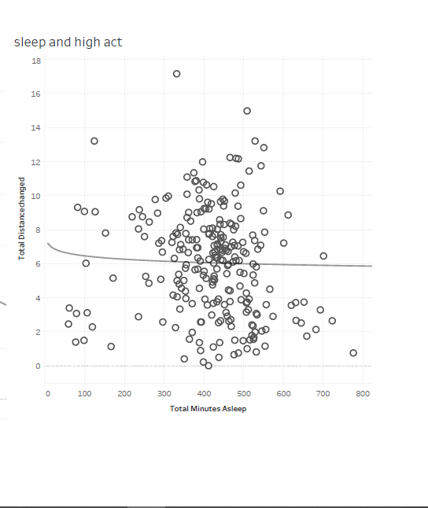
Sleeping rates and high activities
While here it seems that there’s no correlation between high activities and sleep , not like sedentary activities.

Slide 7
And finally the Bmi and Calories charts

Slide 8
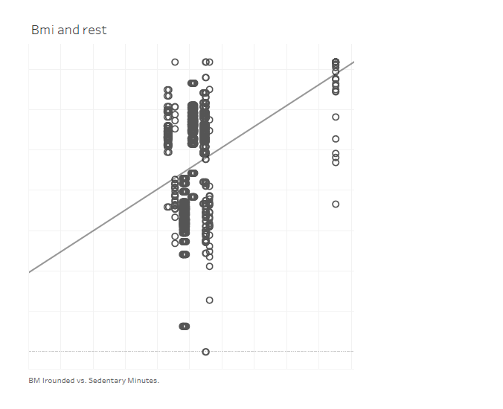
Body mass intenisties and Sedentary Activities
As it’s obvious as much as you don’t move your body aka less activities , the more you will gain body mass

Slide 9
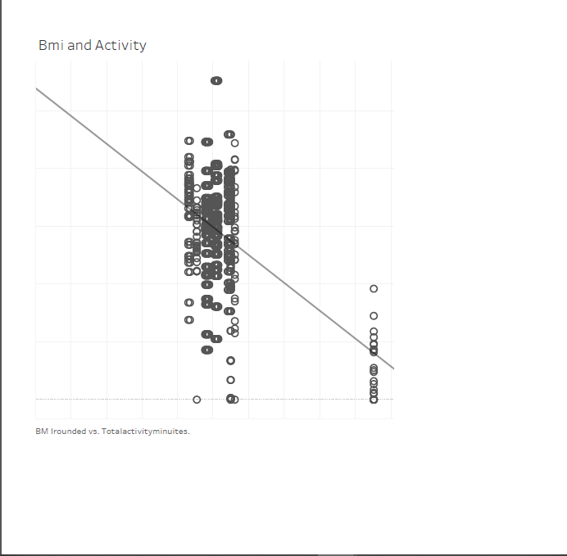
Body mass intenisties and High Activities
Now here it’s the opposite the more you do so, the more you will lose body mass and be in better shape

Slide 10
Recommendations and Updates on products
1- Update the calorie tracking feature to include a more accurate calculation of calories burned during different activities. This could be done by using data from the user's wearable device or by asking the user to manually enter their activity level.
2-Add a feature that tracks the user's sleep patterns and provides personalized recommendations for improving sleep quality. This could include tips on how to create a relaxing bedtime routine, how to avoid caffeine and alcohol before bed, and how to create a comfortable sleep environment.
3- Develop a feature that tracks the user's body mass index (BMI) and provides personalized recommendations for weight loss or maintenance. This could include tips on how to eat a healthy diet, how to increase physical activity, and how to manage stress levels.
4- Make the user interface more user-friendly. This will make it easier for users to track their health data and to understand the recommendations that are being made.
5- Offer more personalized recommendations. This will help users get the most out of the products and improve their health in a way that is tailored to their individual needs.
6- Continue to collect data and improve its algorithms. This will help the company make better recommendations and improve the accuracy of its products.

Slide 11
THANK YOU FOR YOUR PATIENCE, GOOD LUCK!

